Slide 1


Democratizing the Democratization of Measurement
From the Three Estates of Expertise to the Encounter of Values
Chris Borst
McGill University
Notes:
Good morning, everyone. In 2022, Anna Alexandrova and Mark Fabian published a paper entitled “Democratising Measurement: or, Why Thick Concepts Call for Coproduction”. Their paper offers up two theses. First, that, as their subtitle puts it, thick concepts call for coproduction. Second, for a particular way of understanding and achieving that coproduction. They frame this understanding as democratising measurement. Today, I’d like to offer a critique of their argument. I think their first thesis is quite right. But, I don’t think their second thesis goes far enough. So, the question I will attempt to answer is, what would it take to actually democratize measurement?

Slide 2
The Big Question
“How do we measure concepts that are ‘thick’, ‘essentially contested’, Ballung – where the descriptive and normative-evaluative contents of the concepts can’t be separated?”
Protest image: Jessica Rinaldi/The Boston Globe
Notes:
But, first, let us start with the big question. Most of the concepts we aim to measure, certainly in the human sciences, but beyond them as well, are what the philosophers call “thick”. The descriptive content of the concept and the evaluative content of it simply cannot be separated. One can think of easy examples like “poverty” or “inflation” or “democracy”, but the example I’ll touch on today is “child well-being”.
With such concepts, there are invariably numerous quite different things which can all be described by them, from different evaluative standpoints – the concept is a “Ballung”, a cluster. As a result, the choice of which to actually describe with the concept necessarily carries with it an evaluative standpoint. Given a dissensus on values, such choice is always – that is to say, essentially – contested. If a key goal of measurement is to promote clarity and consensus on the state of what is measured, how then should we measure such concepts?

Slide 3
Measuring Thick Concepts Alexandrova & Fabian (2022)
Three Strategies:
redefine thick concepts as technical terms
not “appraising” but “characterising” value judgments
assume full responsibility for making the relevant value judgement
offer explicit normative argument by appeal to personal intuition or disciplinary consensus
make the value judgment through a legitimate political process
take into account the judgements of those affected by the research
Notes:
Alexandrova and Fabian outline three strategies that can be pursued.
First, you can try to simply redefine the thick concepts as technical terms. They cite Ernst Nagel’s distinction between “appraising” and “characterising” value judgements as an attempt to justify this practice. Nagel claims one can “characterise” instances from some evaluative angle, without necessarily endorsing the “appraisal” embodied in that evaluation. In effect, this strategy attempts to disclaim responsibility for the value judgements involved by outsourcing them. But, of course, however much one might disclaim responsibility for them, the value judgements are still there, which makes a difference to what a paper says.
Second, you can assume responsibility for making the value judgements involved. In this case, the researcher would need to offer an explicit normative argument for the operationalization they adopt. Alexandrova and Fabian cite personal intuition or disciplinary consensus as the key forms of this appeal. By “personal intuition” they evidently mean attempting to make a substantive argument for a particular perspective. But the reference to disciplinary consensus points to the fact that one can still outsource the value judgements one uses. The difference is that, in this context, one acknowledges and defends the value choice made, rather than pretending that, by outsourcing the choice, the concept has therefore become value-free. But, regardless of the argument made, it remains the case that the judgement being made is the researcher’s alone. Alexandrova and Fabian argue this takes hubris and threatens coercion of those on the receiving end of the measurement, especially where the measure’s use is close to action, as in policy, law, medicine, social work, and education.
Which brings us to the third strategy: seeking political legitimacy. Where value judgements can’t be avoided and where interests other than the researcher’s own are at stake – which is almost everywhere – then some kind of process is needed that, in the authors’ words, “takes into account the relevant value judgments of those whose lives stand to be affected by [the] research”. It will be clear that the political legitimacy they have in mind is a democratic legitimacy. So, how is that to be achieved?

Slide 4
Co-production* Alexandrova & Fabian (2022)
“an arrangement for sharing power and responsibility in the process of defining thick concepts and developing their measures … [requiring], first, recognising different types of expertise …, second, ensuring that the final products meet, to the extent that it is possible, the demands stemming from each type of expertise”
Stakeholder Role | Distinctive Expertise
Members of public, especially service users | Lived expertise
Scholarly researchers | Technical expertise about theories and measurement
Policy makers and service providers | Professional expertise about delivery and implementation
Notes:
While recognizing that there will be different ways to accomplish this in different research contexts, they focus on an arrangement that they denote “co-production-asterisks”. As they define it, “an arrangement for sharing power and responsibility in the process of defining thick concepts and developing their measures … [requiring], first, recognising different types of expertise …, second, ensuring that the final products meet, to the extent that it is possible, the demands stemming from each type of expertise”.
They recognize three different stakeholder groups. First, members of the public – and, given their focus on contexts “close to action”, especially service users. Second, scholarly researchers. Third, policy makers and service providers. To each of these groups they attribute a characteristic expertise. Lived expertise for users, technical expertise for researchers, and professional expertise for policy makers. They expect the different stakeholders to make their principal contributions in different areas. But the key is that each stakeholder group is conceived as bringing to bear a distinctive expertise and (I quote) “A good measure … is one that emerges when the three sets of experts learn from each other in an equal and productive arrangement”.
Now, measurement development projects of just this sort have been underway since at least the 1990s, particularly in medicine and social work, and mostly being conducted within the framework of the Delphi Method. So, while this philosophical proposal is recent, the practice it commends is well-established. But, it should be noted that a shift takes place in defining their “co-production-asterisks”. The problem posed was value-ladenness and the plurality of values. The solution proposed addresses the plurality of expertise.

Slide 5
Democratic Legitimacy
The emergence of “popular sovereignty”:
Pre-1789: the Estates-General
nobility, clergy, “commons”
Post-1789: Parliament/Congress/National Assembly
elected representatives, eventually by universal adult sufferage
Post-1871: Councils/Soviets/Neighbourhood assemblies
direct meetings of the people: “workers, peasants, and soldiers”
Notes:
In assessing this proposal, it’s worth taking a moment to revisit the ideas and history underlying the contemporary idea of democratic legitimacy and popular sovereignty. The classic contrasts in these ideas are articulated in terms of the political history of France.
In pre-revolutionary France, the king, not the people, was sovereign. More, “the people” as such was not a recognized entity. Rather, there were three estates: the nobility, experts in rule; the clergy, experts in symbolic manipulation; and the commons, everyone else.
“The people” and their sovereignty were constituted by the Revolution. Their sovereignty was exercised in a National Assembly of elected representatives. It would take well over a century before the franchise in these elections would be extended to all adult citizens. In the meantime, there was continual upheaval.
The most significant of these upheavals for democratic theory was the Paris Commune of 1871. The commune embodied the rejection of representation by notables. Rather, there were neighbourhood assemblies, councils, where working people met to decide on rules for themselves, directly. The tension between representative and participatory democracy has been the key question ever since.
In light of these contrasts, the proposal of Alexandrova and Fabian seems not so much a democratizing of measurement, as a call to step back from the position of researcher-monarch and to convene “estates-general” between the three estates of policy makers, scholars, and everyone else: the Three Estates of Expertise.

Slide 6
Democratic Legitimacy
There is only the Third Estate:
The issue: differences of values, not differences of expertise
Everyone is (just) a “member of the public”
If anything, must privilege more marginal voices
Notes:
Following this metaphor through, democratizing measurement requires not just bringing together the three estates, but overthrowing them. More specifically, overthrowing the basis for their distinction: the question of expertise. This is where I come back to how Alexandrova and Fabian define their problem. The problem they initially posed was the problem of value-ladenness, given the plurality of values. The problem they proposed to solve is the plurality of expertise. Solving the latter need not do anything for the former. And the problem that needs solution really is the problem posed by the plurality of values, not the plurality of expertise.
Crucially, on the grounds of values, “experts” – researchers and policy makers – can claim no privilege over anyone else. Their values are their preferences in exactly the same way and to exactly the same degree as anyone’s preferences are their own preferences. Everyone just is a “member of the public”, there is only the Third Estate. Indeed, if there is anyone who can claim some kind of privilege in a democratic setting, it is – in keeping with the spirit of the Commune – those whose voices are otherwise marginalized, be that on grounds of class or gender or race or age or sexuality or disability or citizenship or otherwise.

Slide 7
Implications
The need for encounters between values:
McClimans’ “epistemic dialogues”
privilege dialogue with “those who are different from us”
Rodriguez Duque, et al.’s “ethical iterations”
“structured procedures for implementing the value deliberations involved in psychosocial measure design and use”
Limits: the Habermas-Mouffe debate on “deliberative democracy”
democracy is unavoidably agonistic
Notes:
Which brings me to my thesis. Alexandrova and Fabian argued that measures of thick concepts could and should obtain a democratic political legitimacy through arranging an encounter between expertises. I argue that measures of thick concepts can only obtain a democratic political legitimacy through arranging encounters between values.
Leah McClimans’ new book on patient-centered measures, which we heard a discussion of this morning, offers us one possible conceptualization of such an encounter, in her “epistemic dialogues”. She frames these as “conversations in which we explore possibilities, compare values and arguments, consider alternative world views and so on”. Thus, their purpose is “not to argue with others or to become self-satisfied with our own position, but rather to offer provocation in the form of questions so we can foreground and examine our own assumptions and values”. Crucially, such dialogues require that “we seek out those who are different from us because they are the ones whose positions are best placed to put our own assumptions and values into question.”
A recent paper by Sebastian Rodriguez Duque, Eran Tal and Skye Barbic extends and enriches this with a proposed five-step procedure they call “ethical iterations”. Their steps are,
one, reflection on the values currently informing measurement for a given concept;
two, collection of evidence on the consequences of the current value choice;
three, collection of evidence on the values of interested parties;
four, normative evaluation and revision in light of the evidence collected; and,
five, modifying the measurement theory and/or practice accordingly.
Before saying more about the various reflections on values in this process, I want to draw attention to a key limitation of any encounter of values, no matter how dialogic or iterative. Values are challenging because we don’t all just agree. So, the process of values deliberation in measurement may aspire to consensus, but it can’t expect to achieve one. McClimans acknowledges this, but doesn’t dwell on it, while Rodriguez Duque, et al., take it as an area for future work. In the context of democratic theory, we have a recapitulation of the debate between Jürgen Habermas and Chantal Mouffe over deliberation. While Habermas’ theory requires the postulation of a possible consensus, at least in an “ideal speech situation”, Mouffe argues that democratic politics is unavoidably conflictual or, as she puts it, agonistic. While deliberation can improve our choices, there remains a limit at which we must either follow Cartwright and Runhardt’s recommendation to use a table of indicators or decide to simply ignore certain relevant value positions.

Slide 8
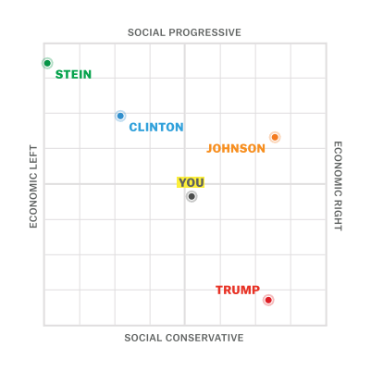
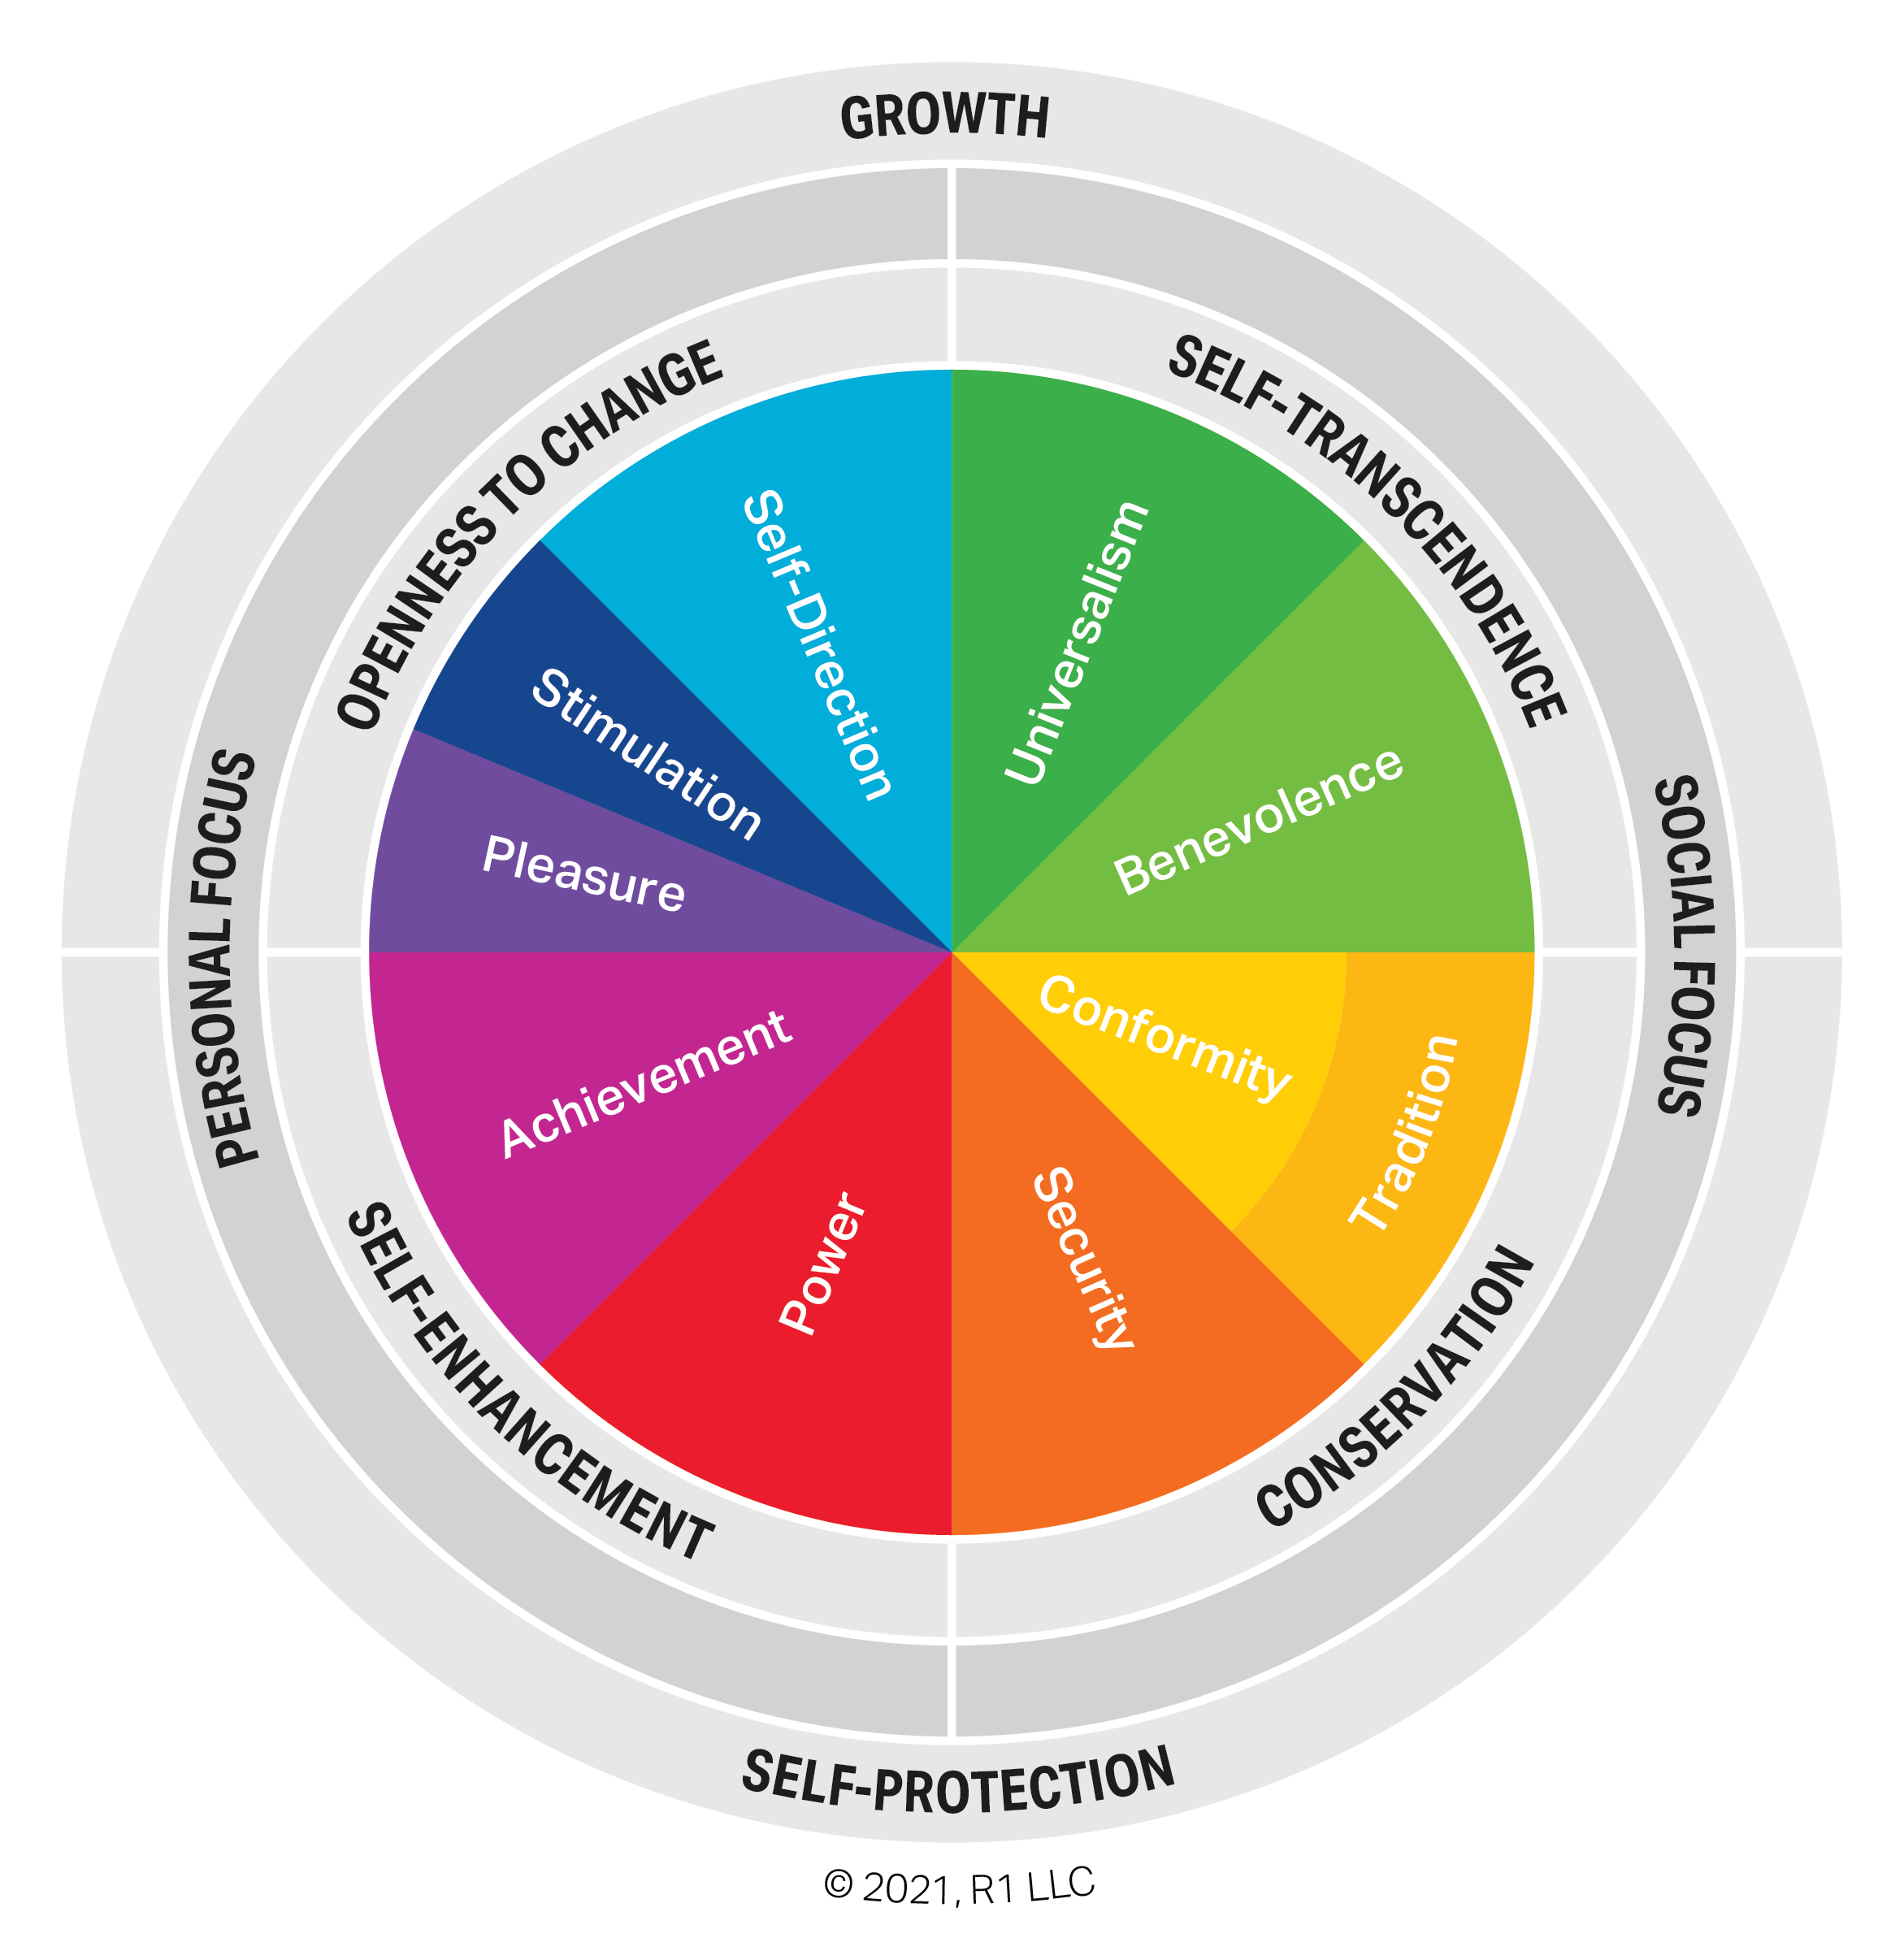
Implications: Mapping Values
Source: VoteCompass.com via Vox.com
Source: r1learning.com
Notes:
Now, if we want to seek out those different from us, as McClimans recommends, and if we want to reflect on our current values, possible alternative values, and, in particular, collect evidence on the values of interested parties, as Rodriguez Duque, et al., recommend, then it would help to have some kind of schematic of what the variation in values is, relative to the concept at hand. Typically, we rely on informal processes, background knowledge, and rough rules-of-thumb for this. If we want to achieve greater rigour in our measures, though, then we need greater rigour in our assessment of the values at stake. It would help to have some kind of what Leigh Star calls a boundary object in order to coordinate the interaction of multiple parties to the measurement situation. Evidently, this is itself a measurement problem, but it is a problem for which we do have examples of how it can be managed.
Certainly, there can be few more successful measures for coordinating the interaction of people with vehemently opposed values than the concept of the political spectrum. Epistemic and ethical iterations have recast it into a minimum of two dimensions, but its ideal types and their relationships have coordinated not just political theory and political science, but actual political practice for over 200 years, at least in the WEIRD countries. And, the political spectrum may just be a simplified projection of a more general values space, as is suggested by the image on the right here, which is a schematization of the eight- or ten-dimensional model of cross-cultural values developed by Shalom Schwartz and that has been incorporated into the European Values Study.
But, my point is that we have experience, as a scientific community, with measuring values. Schematizing how pertinent values vary with respect to a given concept which we would like to measure should, therefore, be entirely possible and would facilitate the productive and iterative encounter of values.

Slide 9
Child Well-Being Raghavan & Alexandrova (2015) and Alexandrova (2017)
A “two sources” theory of child well-being:
Well-becoming –
version of a developmentalist “objective list” theory due to inadequacy of “hedonist” and “subjectivist” theories
Develop those stage-appropriate capacities that would, for all we know, equip them for a successful future, given their environment
Non-reduction –
Engage with the world in child-appropriate ways
Notes:
As an example of what this might look like, I would like to consider the case of child well-being. This concept is the focus of my own research, following years evaluating children’s services in municipal government. But it is also a privileged example for Alexandrova herself. In a 2015 article co-authored with Ramesh Raghavan and in chapter 3 of her 2017 book, A Philosophy for the Science of Well-Being, she outlines what she calls a Two Sources theory of child well-being.
The Two Sources theory argues that children are doing well when they meet two conditions. First, the condition of well-becoming, wherein children “develop those stage-appropriate capacities that would, for all we know, equip them for a successful future, given their environment.” Second, the condition of non-reduction, which it cashes out as “engaging with the world in child-appropriate ways”, suggesting examples of such ways as “curiosity and exploration, spontaneity, and emotional security”.
To understand these two conditions, it is important to appreciate that the idea of “well-becoming” was first articulated as a criticism of developmentalist accounts of childhood. The Two Sources theory aims to embrace a developmental account of childhood, but without simply ignoring this critique. Hence the condition of “non-reduction”, by which is meant that child well-being cannot simply be reduced to predictors of some version of adult well-being. A worthwhile theory of child well-being has to recognize a well-being that inheres in childhood itself.
The key feature of this theory is that the lists of capacities to be developed and child-appropriate ways to engage are conceived as objective, that is, as definable by adult third-parties. A so-called “hedonist” approach, that asks children to assess their own happiness, is dismissed on account of children’s immature “emotional apparatus”. Similarly, a so-called “subjectivist” approach, that asks children about their preferences, is dismissed on account of children’s inadequate “executive functioning”. Indeed, the theory specifically endorses developmentalism because “it does not set a high bar on rationality.”

Slide 10
Child Well-Being
“What is your image of the child?”
dismissal of children’s own understandings and valuings
children as deficient
the experts, once again
developmentalism because the developmentalists say so
objective list is not as “objective” as you think
which “developments” count?
Notes:
In the reconceptualist critique of early childhood education, researchers are encouraged to begin their work by reflecting on the question “what is your image of the child?” Substantively, this is a demand very much like Alexandrova’s call for a theory of child well-being. But the image of childhood she finds amenable would find little sympathy in such corners or in Childhood Studies more broadly.
While she acknowledges the criticisms of a “deficit approach” to childhood, her argument commits her to such an approach very strongly. Immature emotional apparatus. Inadequate executive functioning. Setting a low bar on rationality. It is hard to see this as anything but a conception of children as defective adults – a species of elitism that has been decried as “adultist”. She suggests that “child-appropriate ways” of engaging with the world offer some counter to these deficiencies, but these don’t save children’s own understanding and valuing of their lives from dismissal.
In developing the Two Sources theory, she relies heavily on the existing scholarship on children in developmental psychology, education, and the like. A key part of her argument is that developmentalism is generally taken for granted in such contexts, so must be part of any adequate theory of child well-being. Once again, we find a privileging of “the experts”.
But this is not the only direction from which the Two Sources theory is subject to critique. Even for those who endorse objective lists of developmental capacities, the choice of which capacities to include is fraught. One can find multiple measures in the literature of spiritual or religious development. Moral development has been widely discussed since Kohlberg’s work in the 60s. Racial, ethnic, or (more broadly) cultural development has seen focused study, particularly for minority communities in North America – Black, Hispanic, Indigenous. Yet, these go unmentioned.
In the present context, I mention these different critiques as examples rather than working them out. The alternatives raised point precisely to where there are grounds for encounters of values.

Slide 11
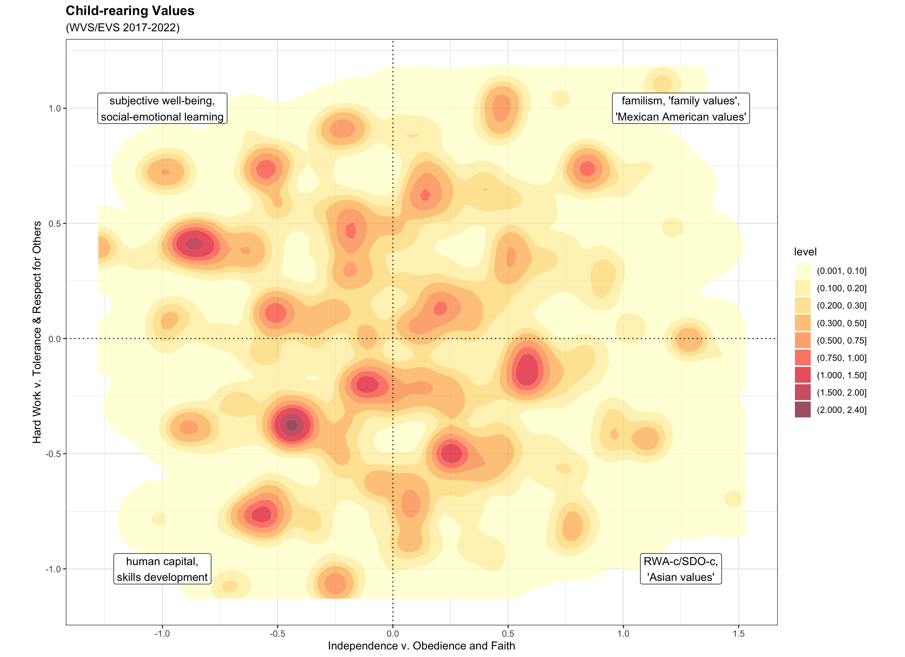
Child Well-Being: Mapping Values
Notes:
This image is similarly illustrative of how the values pertinent to a thick concept could be schematized, so as to facilitate an encounter of values. I should note that this is the area of my present work, as I don’t consider this example to be an adequate schematization, but it serves the purpose of illustration.
The data for this image is drawn from the latest wave of the World Values Survey, which asks respondents to endorse up to five qualities from a list of eleven that it is important that children learn at home. The first two principal components of those responses contrast, first, independence with obedience and faith, and, second, hard work with tolerance and respect for others. The colours reflect the distribution of individual responses.
It's worth thinking through how different measures, and their accompanying conceptions of child well-being, align with different locations in this values space. Subjective well-being, as instantiated in the “hedonist” Children’s Worlds Survey or the “subjectivist” Children’s Understandings of Well-Being project, are aligned with independence and tolerance. Human capital analyses, of the type associated with James Heckman and his co-authors, align more with the independence and hard work quadrant. More culturally-specific accounts tend to align more with the obedience and faith side of the space. Development can be approached from all corners, but different capacities are focal for each.
This is an area requiring further work, so I’ll leave it there.

Slide 12
Conclusion
How do we measure thick concepts?
By seeking operationalizations with political legitimacy
This demands an encounter of values, not of expertises
The encounter is coordinated by schematizing pertinent values
Legitimacy lies not in consensus, but in the encounter
Notes:
The problem of how to go about measuring thick concepts is a key problem for the very possibility of a human science. The thesis that thick concepts call for coproduction is, I think, exactly right. The legitimacy of a measure depends on how many, and which, people see their values reflected in it and can use it to meet their needs. But, I argue that, where the legitimacy desired is a democratic legitimacy, securing it demands not an encounter of expertises, but an encounter of values. Such an encounter is facilitated and coordinated by a particular kind of boundary object, a schema of how the values pertinent to that thick concept vary. An encounter of values may aspire to consensus, but cannot expect to achieve it. The legitimacy sought lies not in achieving consensus, but in the encounter itself.

Slide 13

THANK YOU!
QUESTIONS?
chris.borst@mail.mcgill.ca
Works discussed listed and linked at: https://imageofthechild.org/2024/08/03/democratizing-measurement/
Notes:
Thank you.

